Slide 1
Superstore Sales & Profitability Analysis (USA)
Tool: Power BI
Dataset: Sample Superstore (USA – 50 States)
Focus: Sales, Profit, Discount, Category & Regional Performance

Slide 2
Objective of Analysis
Objective:
  Identify profit improvement opportunities within existing sales.
Questions
  Is the business profitable overall?
  Where are losses occurring despite high sales?
  Which categories, sub-categories, and regions drive profit erosion?
  How does discounting affect profitability?

Slide 3
Data Preparation & Assumptions
Data context
  Transaction-level order data
  Geography limited to USA
  Key metrics: Sales, Profit, Quantity, Discount
Important assumption:
  Sales and Profit are post-discount
  Discount is used for correlation analysis, not recomputation
  Cost and list price are not available

Slide 4
Data Preparation & Modeling
Power Query:
  Correct data types
  Derived Year and Month
Model:
  Single fact table
  Non-analytical columns hidden
Purpose:
  Ensure analysis is based on reliable data.

Slide 5
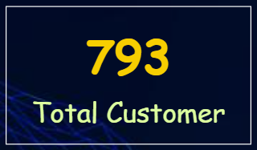



Overall Business Performance
High-level KPIs
  Total Sales: $2.29M
  Total Quantity : 38k
  Total Orders : 5009
  Total Profit: $286K
  Overall Profit Margin: ~12.5%
  Average Discount: 15.62%
Observation:
  Business is profitable at an aggregate level
  This suggests internal inefficiencies, not weak demand.

Slide 6
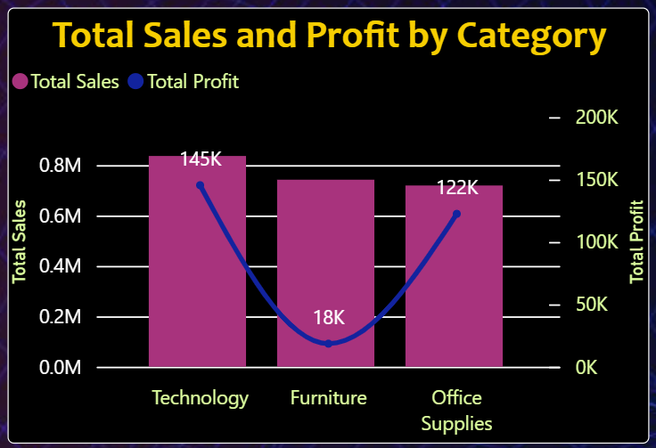
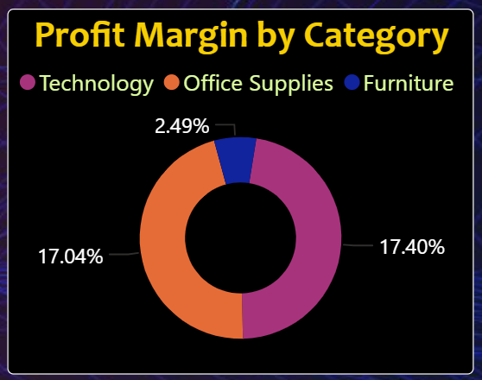
Category-Level Performance
Sales vs Profit reality
Technology
  Highest profit contribution
  Strong and consistent margins
Office Supplies
  Stable profitability
  Lower volatility
Furniture
  High sales volume
  Weak overall profit margin (~2–3%)
Insight: Furniture generates revenue but contributes disproportionately less to profit.

Slide 7
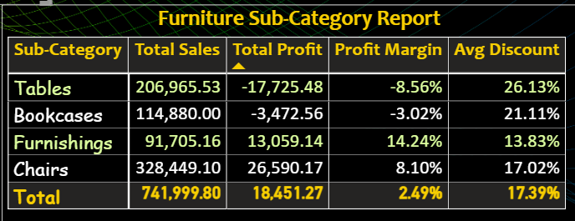
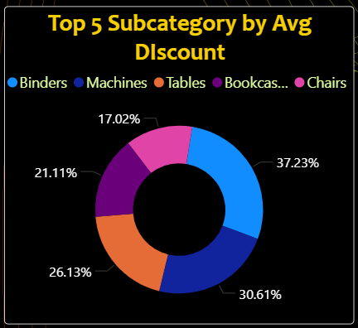
Furniture Sub-Category Analysis
Why Furniture underperforms (Sub-category breakdown)
Tables
  High sales
  Significant losses
  High average discounts
Bookcases
  Negative profit
Chairs & Furnishings
  Positive profit
  Better margin control
Conclusion: Losses in Furniture are driven by specific sub-categories, not the entire category.

Slide 8
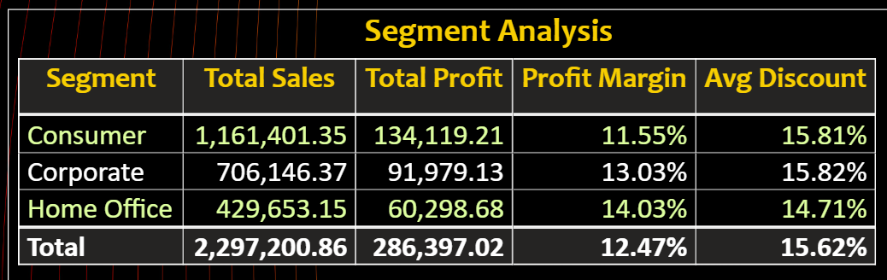
Segment Analysis
Who buys profitably
Consumer
  Highest sales volume
  Moderate profit margin
Corporate
  Lower sales than Consumer
  Better margin discipline
Home Office
  Lowest sales
  Highest profit margin
Interpretation: High-volume customers are not always the most profitable customers.

Slide 9
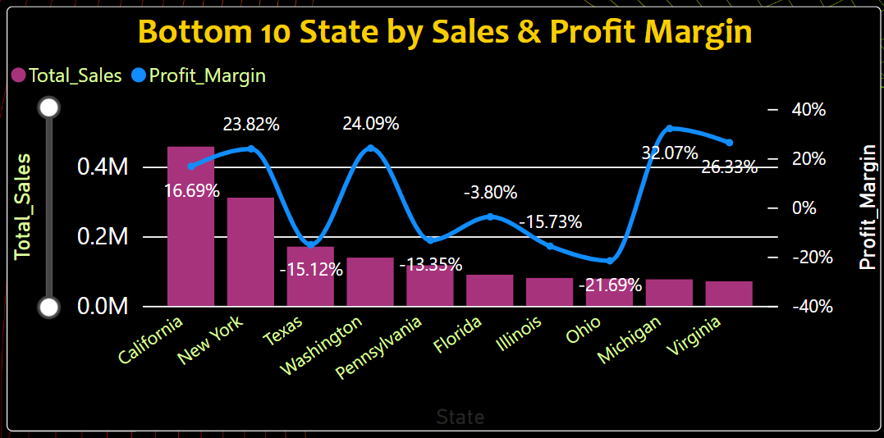
State-Level Loss Analysis
Worst-performing states
  Texas
  Ohio
  Pennsylvania
  Illinois
  North Carolina
Common traits:
  High sales volume
  Negative profit margins
  Elevated average discounts
Insight: These states are not demand-poor — they are margin-poor.

Slide 10
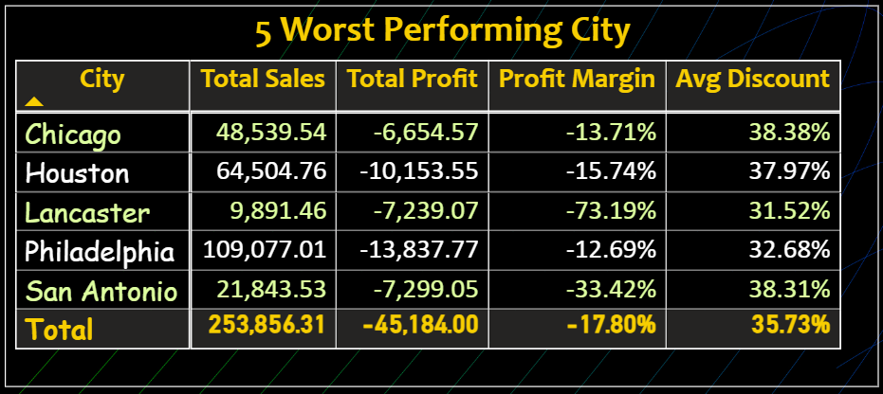
City-Level Loss Analysis
Cities contributing most to losses:
  Houston
  Chicago
  Philadelphia
  San Antonio
  Lancaster
Pattern observed:
  Extremely high discounts (30–40%)
  Strong sales but consistently negative margins
Conclusion: City-level discounting decisions are eroding profitability.

Slide 11
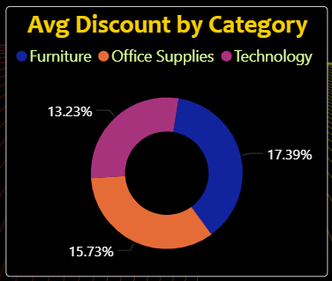
Discount Impact Analysis
Discount vs Profit relationship
Observed behavior:
  Low to moderate discounts support profitability
  High discounts sharply reduce margins
  Certain sub-categories are extremely discount-sensitive
Key insight:
  Discounting is the primary driver of losses, not low sales volume.

Slide 12
Key Conclusions
What the analysis clearly shows
Business is profitable overall but inefficient
Losses are concentrated in:
  Furniture sub-categories (Tables, Bookcases)
  Specific states and cities
Aggressive discounting is consistently linked to negative margins
High sales regions are not necessarily profitable regions

Slide 13
Recommendations
Short-Term Actions
  Cap discounts for loss-making sub-categories
  Review pricing strategy in high-loss states and cities
  Reduce focus on revenue-only performance metrics

Slide 14
Recommendations
Long-Term Actions
  Introduce discount governance by region
  Shift portfolio mix toward high-margin categories
  Track profit-first KPIs instead of sales-only KPIs
  Closing statement: “Improving margins within existing sales is faster and safer than chasing new revenue.”

Slide 15
END

